Slide 1




Bank Marketing case study
By Akhilesh Tawde

Slide 2
Problem Statement
The aforementioned data set includes direct marketing campaigns (i.e. phone calls) of a Portuguese banking institution.
The goal is to predict if the client will subscribe a term deposit (indicated in the y variable).
Aim to increase campaign efficiency by identifying the main factors that affect the success of a campaign and predicting whether the campaign will be successful to a certain client, namely, whether the client will subscribe a term deposit

Slide 3

Background:
The increasing number of marketing campaigns over time has reduced their effects on the general public
First, due to competition, positive response rate to mass campaigns are typically very low, according to a study, less than 1% of the contacts will subscribe a term deposit
Second, direct marketing has drawbacks, such as causing negative attitude towards banks due to intrusion of privacy
Notes:
In order to save costs and time, it is important to filter the contacts but keep a certain success rate.

Slide 4

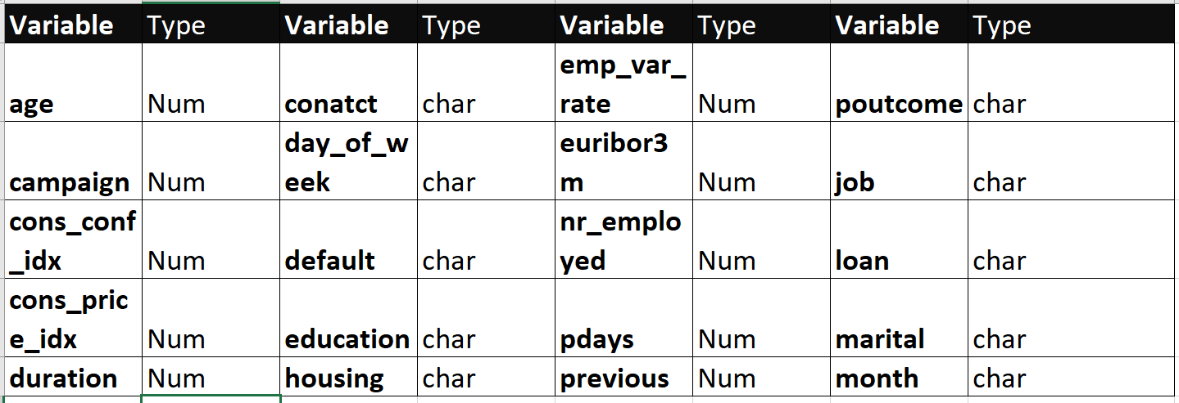
Data Source
Our data were collected from a Portuguese marketing campaign related with bank deposit subscription for 45211 clients and 20 features, and the response is whether the client has subscribed a term deposit.
Our data set is downloaded from http://archive.ics.uci.edu/ml/datasets/Bank+Marketing
Acquisition
Attributes
Notes:
1 - age (numeric)
2 - job : type of job (categorical: "admin.","blue-collar","entrepreneur","housemaid","management","retired","self-employed","services","student","technician","unemployed","unknown")
3 - marital : marital status (categorical: "divorced","married","single","unknown"; note: "divorced" means divorced or widowed)
4 - education (categorical: "basic.4y","basic.6y","basic.9y","high.school","illiterate","professional.course","university.degree","unknown")
5 - default: has credit in default? (categorical: "no","yes","unknown")
6 - housing: has housing loan? (categorical: "no","yes","unknown")
7 - loan: has personal loan? (categorical: "no","yes","unknown")
# related with the last contact of the current campaign:
8 - contact: contact communication type (categorical: "cellular","telephone")
9 - month: last contact month of year (categorical: "jan", "feb", "mar", ..., "nov", "dec")
10 - day_of_week: last contact day of the week (categorical: "mon","tue","wed","thu","fri")
11 - duration: last contact duration, in seconds (numeric). Important note: this attribute highly affects the output target (e.g., if duration=0 then y="no"). Yet, the duration is not known before a call is performed. Also, after the end of the call y is obviously known. Thus, this input should only be included for benchmark purposes and should be discarded if the intention is to have a realistic predictive model.
# other attributes:
12 - campaign: number of contacts performed during this campaign and for this client (numeric, includes last contact)
13 - pdays: number of days that passed by after the client was last contacted from a previous campaign (numeric; 999 means client was not previously contacted)
14 - previous: number of contacts performed before this campaign and for this client (numeric)
15 - poutcome: outcome of the previous marketing campaign (categorical: "failure","nonexistent","success")
# social and economic context attributes----
------------------------------------------------------------------------------------
16 - emp.var.rate: employment variation rate - quarterly indicator (numeric)
17 - cons.price.idx: consumer price index - monthly indicator (numeric)
18 - cons.conf.idx: consumer confidence index - monthly indicator (numeric)
19 - euribor3m: euribor 3 month rate - daily indicator (numeric)
20 - nr.employed: number of employees - quarterly indicator (numeric)
Output variable (desired target):
21 - y - has the client subscribed a term deposit? (binary: "yes","no")

Slide 5
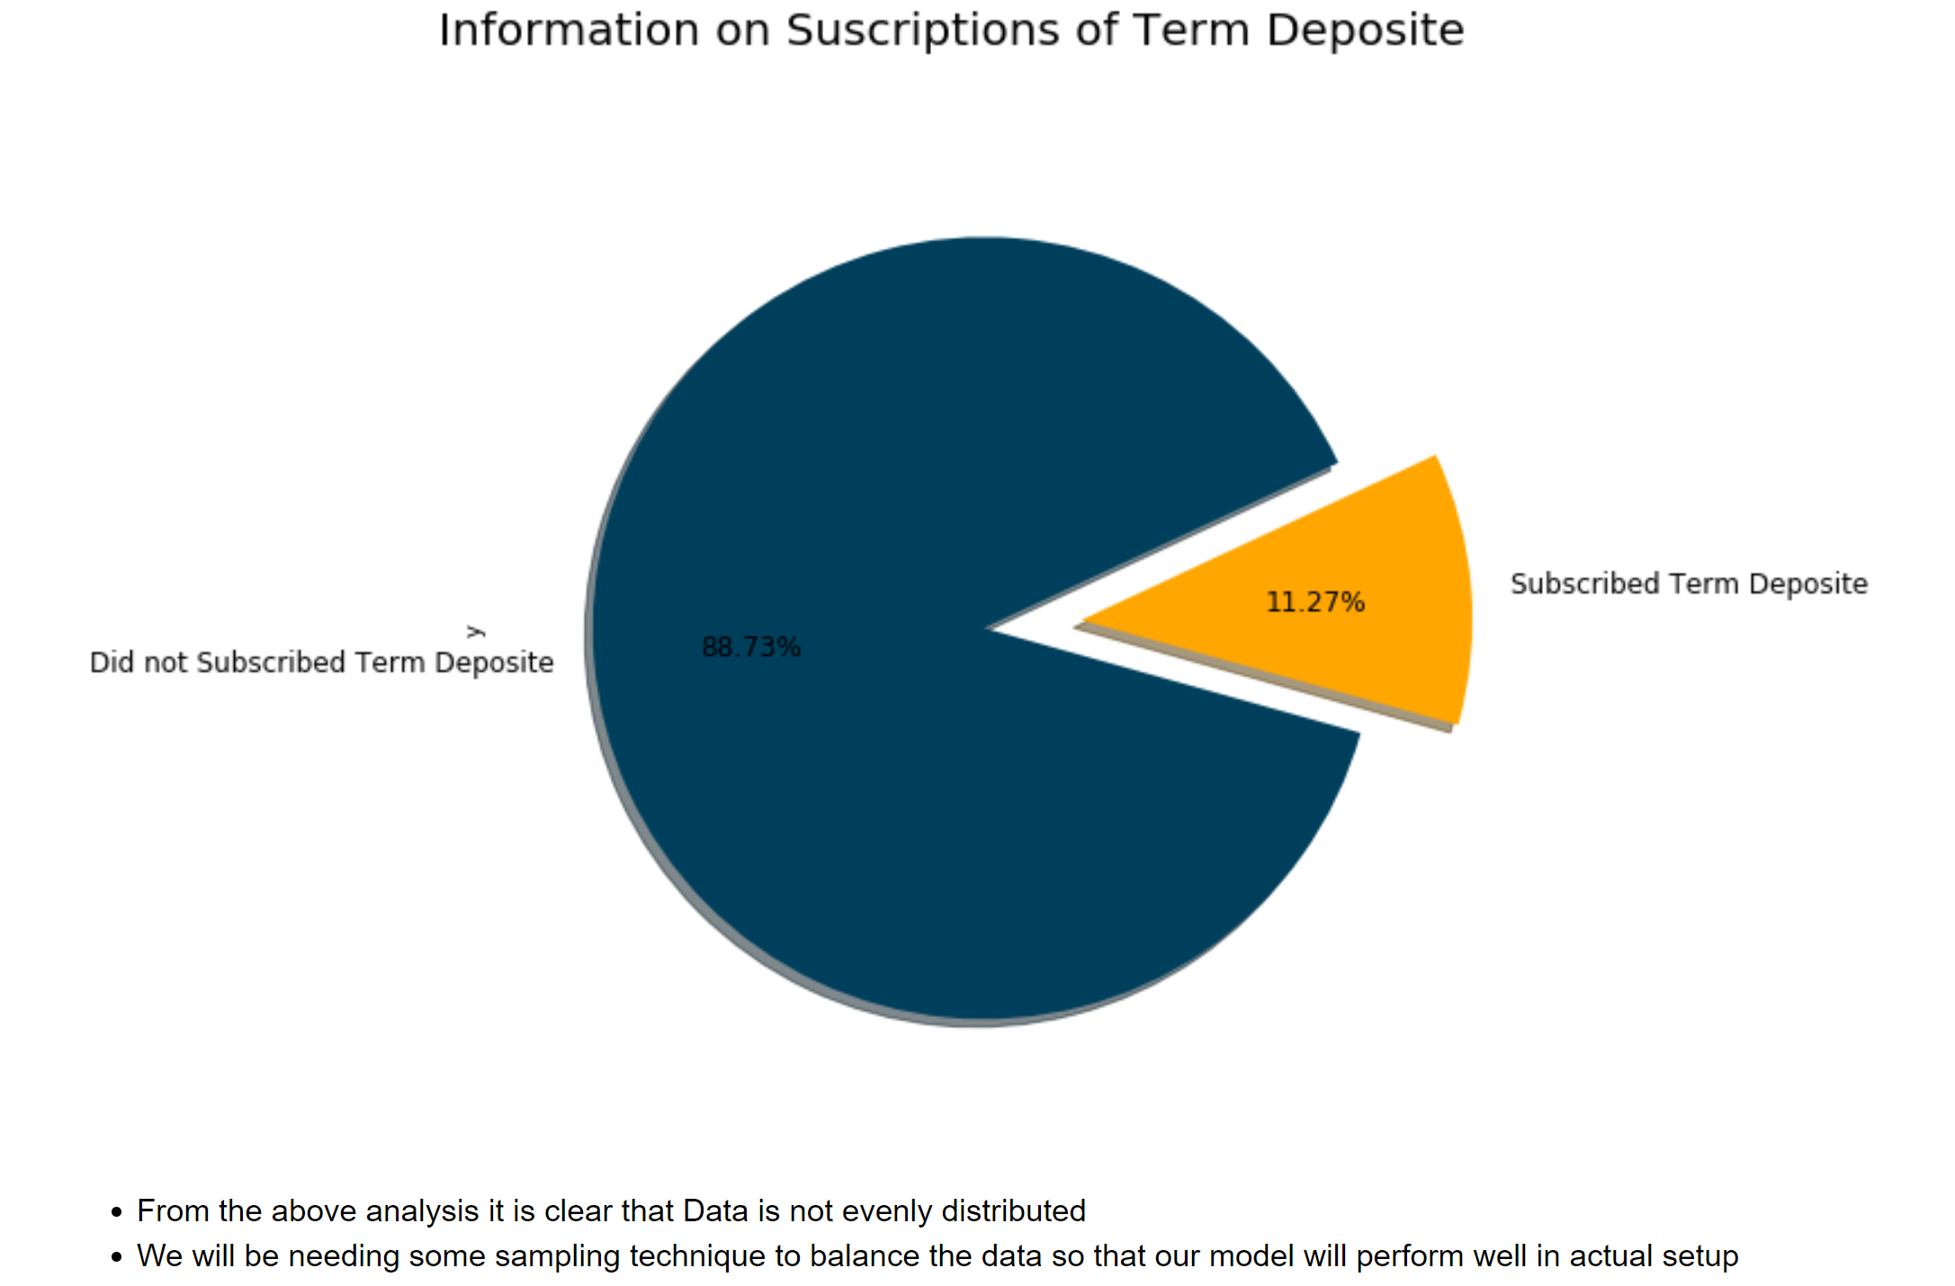
Exploratory Analysis:
From the Analysis it is clear that Data is not evenly Distributed
Some Sampling will be required to balance the Data so that our model performs better

Slide 6
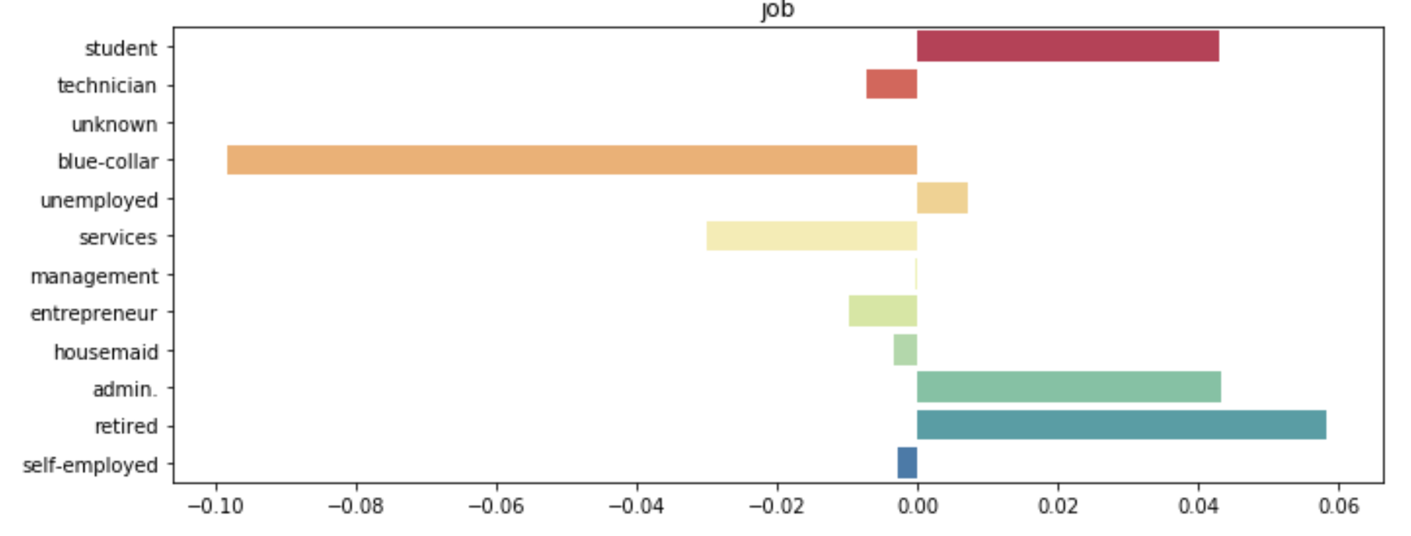
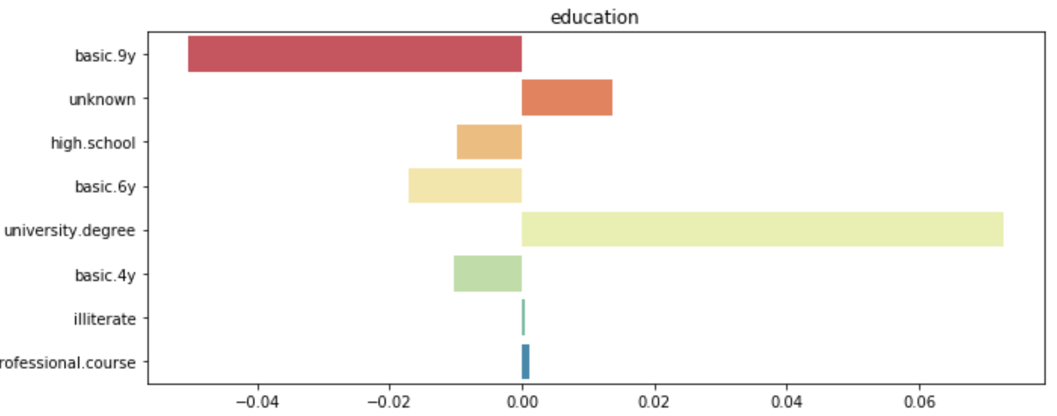
Categorical Exploratory Analysis:
Job Variable
Education Variable
Notes:
Created a Normalized Frequency Graph to understand the importance of categorical variable categories who are willing to take a Term Deposit:-
Here by plotting normalized relative frequency we can imply that job category "retired","admin", "student" are highly likely to subscribe for Term Deposite
Here our normalized frequency graph tell us that marital status"single" are highly likely to subscribe for TermDeposite
Here our normalized frequency graph tell us that Education status "university.degree" are highly likely to subscribe for TermDeposite
There is a variable named "unknown" which we will deal with later
Here our normalized frequency graph tell us that person with No defaults are highly likely to subscribe for TermDeposite
Here our normalized frequency graph tell us that person with Housing loan are highly likely to subscribe for Team Deposite
Here our normalized frequency graph tell us that person with NO loan are highly likely to subscribe for Team Deposite
Here our normalized frequency graph tell us that person contacted by Cellular means are highly likely to subscribe for Team Deposite
As the normalized frequency graph shows the best month to contact any person are "March", "April", "September", "October", "December".
The Campaign should be planed around that period of time
As the normalized frequency graph shows the best day of week to contact any person are "Tuesday", "Wednesday", "Thursday".
As per the Normalize Frequency Graph if outcome of previous campaign is success then we should contact the person
Here most of the values are having "nonexistent" value which means they were not contacted before

Slide 7
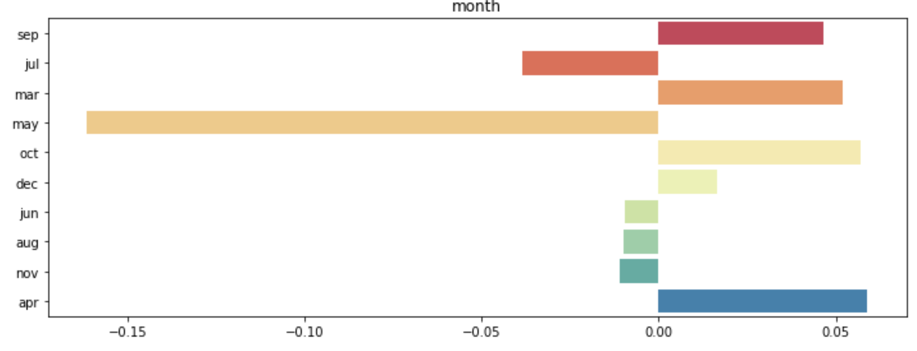
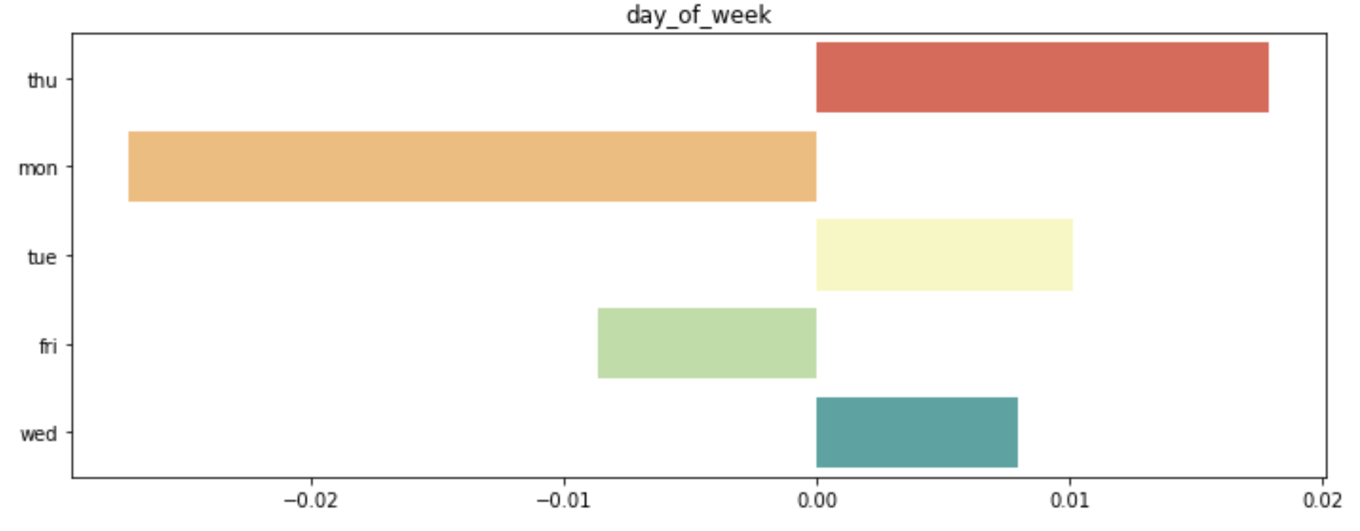
Categorical Exploratory Analysis:
Month Variable
Day Variable
Notes:
Created a Normalized Frequency Graph to understand the importance of categorical variable categories who are willing to take a Term Deposit:-
Here by plotting normalized relative frequency we can imply that job category "retired","admin", "student" are highly likely to subscribe for Term Deposite
Here our normalized frequency graph tell us that marital status"single" are highly likely to subscribe for TermDeposite
Here our normalized frequency graph tell us that Education status "university.degree" are highly likely to subscribe for TermDeposite
There is a variable named "unknown" which we will deal with later
Here our normalized frequency graph tell us that person with No defaults are highly likely to subscribe for TermDeposite
Here our normalized frequency graph tell us that person with Housing loan are highly likely to subscribe for Team Deposite
Here our normalized frequency graph tell us that person with NO loan are highly likely to subscribe for Team Deposite
Here our normalized frequency graph tell us that person contacted by Cellular means are highly likely to subscribe for Team Deposite
As the normalized frequency graph shows the best month to contact any person are "March", "April", "September", "October", "December".
The Campaign should be planed around that period of time
As the normalized frequency graph shows the best day of week to contact any person are "Tuesday", "Wednesday", "Thursday".
As per the Normalize Frequency Graph if outcome of previous campaign is success then we should contact the person
Here most of the values are having "nonexistent" value which means they were not contacted before

Slide 8
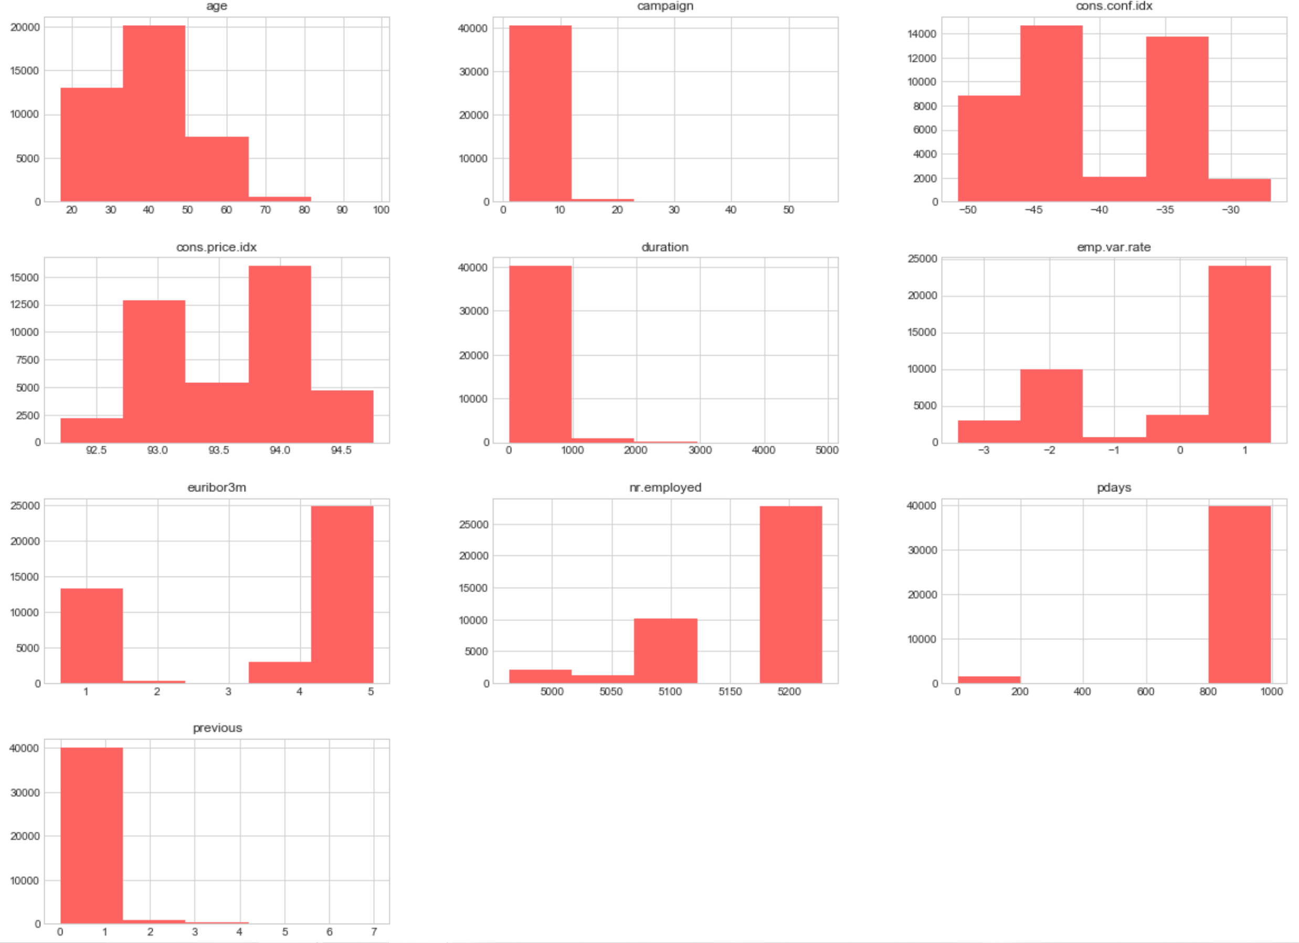
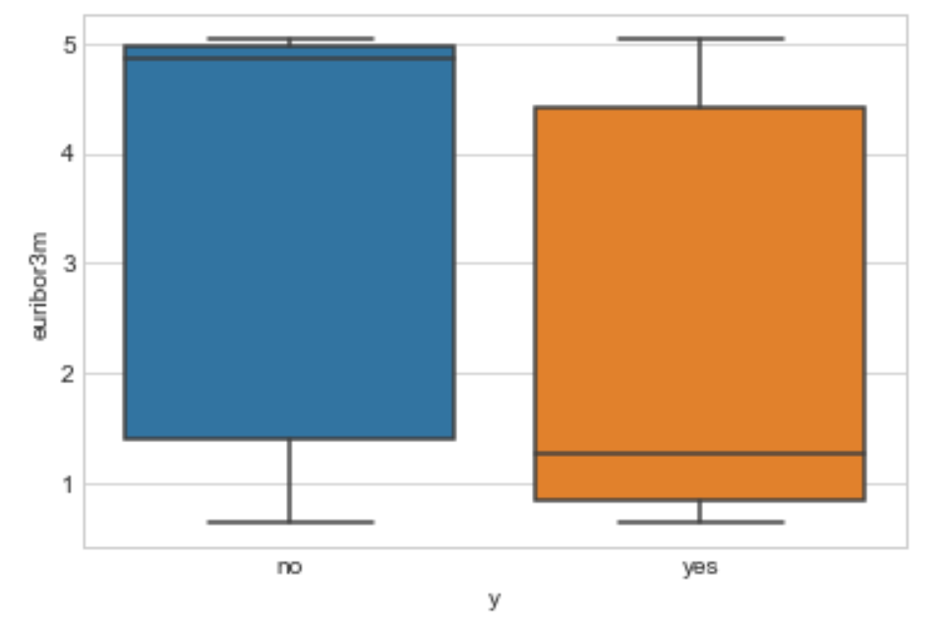
Numerical Exploratory :Analysis:
From the analysis we can see the difference in mean .
Notes:
From the above plot, we can clearly see the difference in median for both the classes. This indicates that the feature can be very useful for our case study.
The emp.var.rate, cons.price.idx, euribor3m and nr.employed features have very high correlation. With euribor3m and nr.employed having the highest correlation of 0.95!
From the source of the data (U.C. Irvine ML Repository), we're told that the missing values, or NaNs, are encoded as '999'. - From the analysis above, it is clear that only 'pdays' has missing values. Moreover, a majority of the values for 'pdays' are missing.
Outliers are defined as 1.5 x Q3 value (75th percentile). From the above table, it can be seen that only 'age' and 'campaign' have outliers as max('age') and max('campaign') > 1.5Q3('age') and >1.5Q3('campaign') respectively.
But we also see that the value of these outliers are not so unrealistic (max('age')=98 and max('campaign')=56). Hence, we need not remove them since the prediction model should represent the real world. This improves the generalizability of the model and makes it robust for real world situations. The outliers, therefore, are not removed.

Slide 9
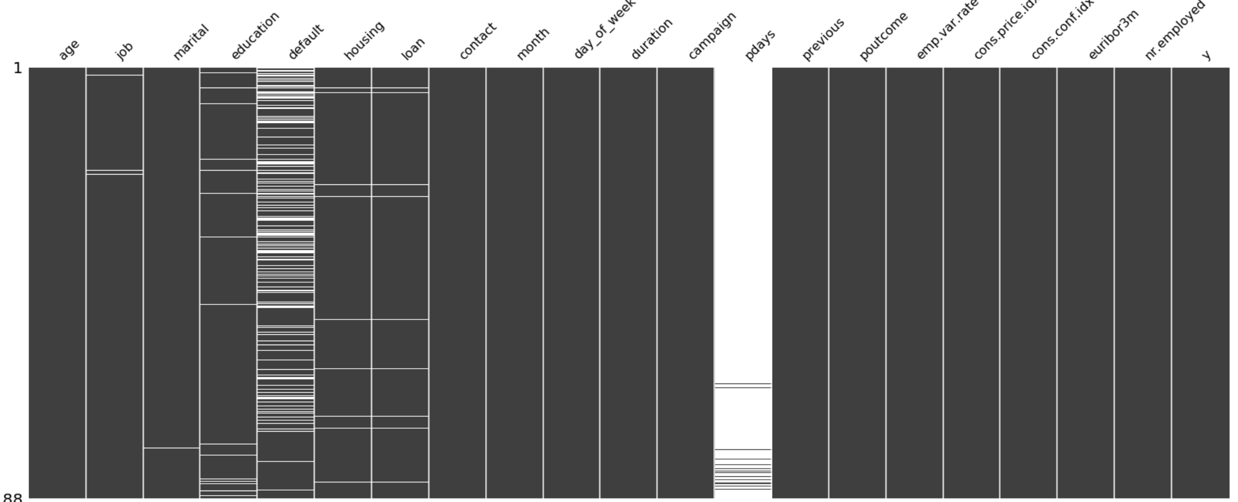
Data Preparation
Awareness
Missing Value
The are missing values in the data set which we will fill using Imputation and Cross Tab Technique
Note : Default Variable are having unknown values which can be a case in real world so we will keep unknown
Standardization
Data Standardization is required to bring the data on same scale
Encoding/Sampling
Encoding Technique is used to convert Categorical Data to Numerical as most of the models dont support Categorical Data
Sampling Technique is used to balance our skewed Data
Notes:
Conclusion on Handling missing value
Used Imputation technique to fill missing value for column 'job', 'education', 'housing', 'loan'
Imputed values were relation between variable made sense and kept the rest as 'unknow' to handle real world situation were a client/customer might not give all the required values
Convered 'pdays' to categorical variable making buckets which made sense w.r.t to data distribution

Slide 10
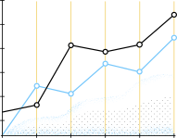
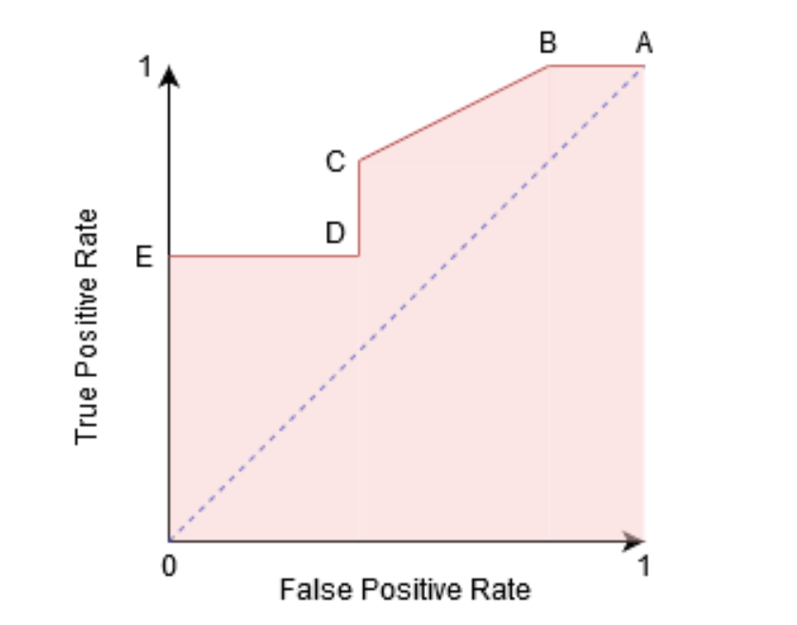
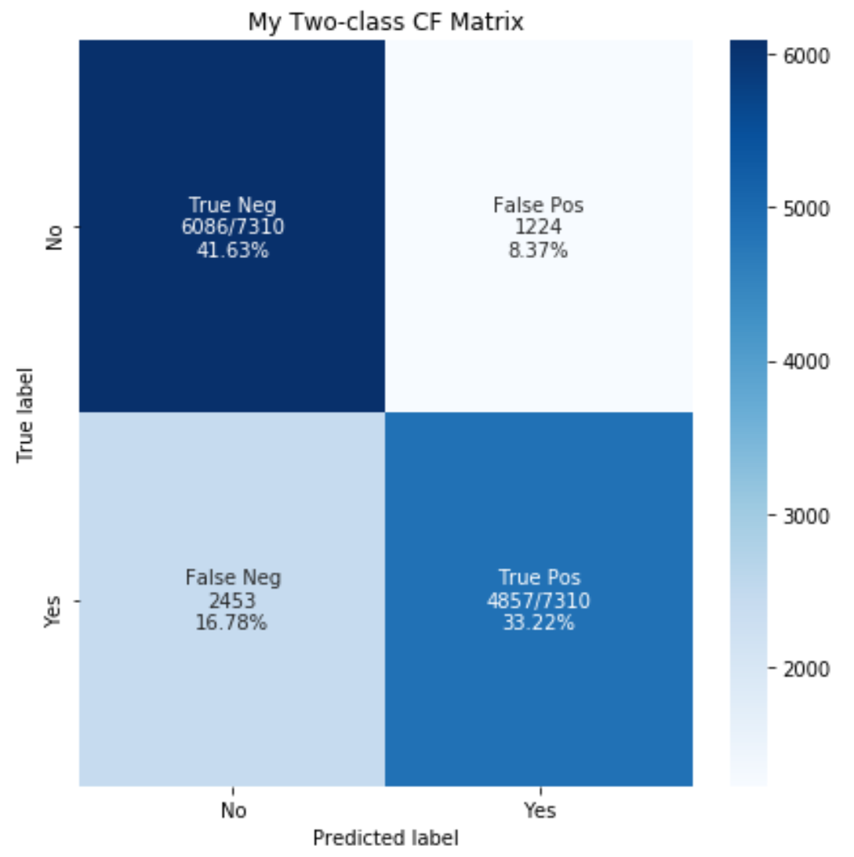
Important Terms for model performance and Metrics:-
ROC
AUC
Confusion Matrix
Notes:
The Receiver Operator Characteristic (ROC) curve is an evaluation metric for binary classification problems. It is a probability curve that plots the TPR against FPR at various threshold values and essentially separates the ‘signal’ from the ‘noise’. The Area Under the Curve (AUC) is the measure of the ability of a classifier to distinguish between classes and is used as a summary of the ROC curve.
The higher the AUC, the better the performance of the model at distinguishing between the positive and negative classes.
A confusion matrix is a table that is often used to describe the performance of a classification model (or "classifier") on a set of test data for which the true values are known.

Slide 11
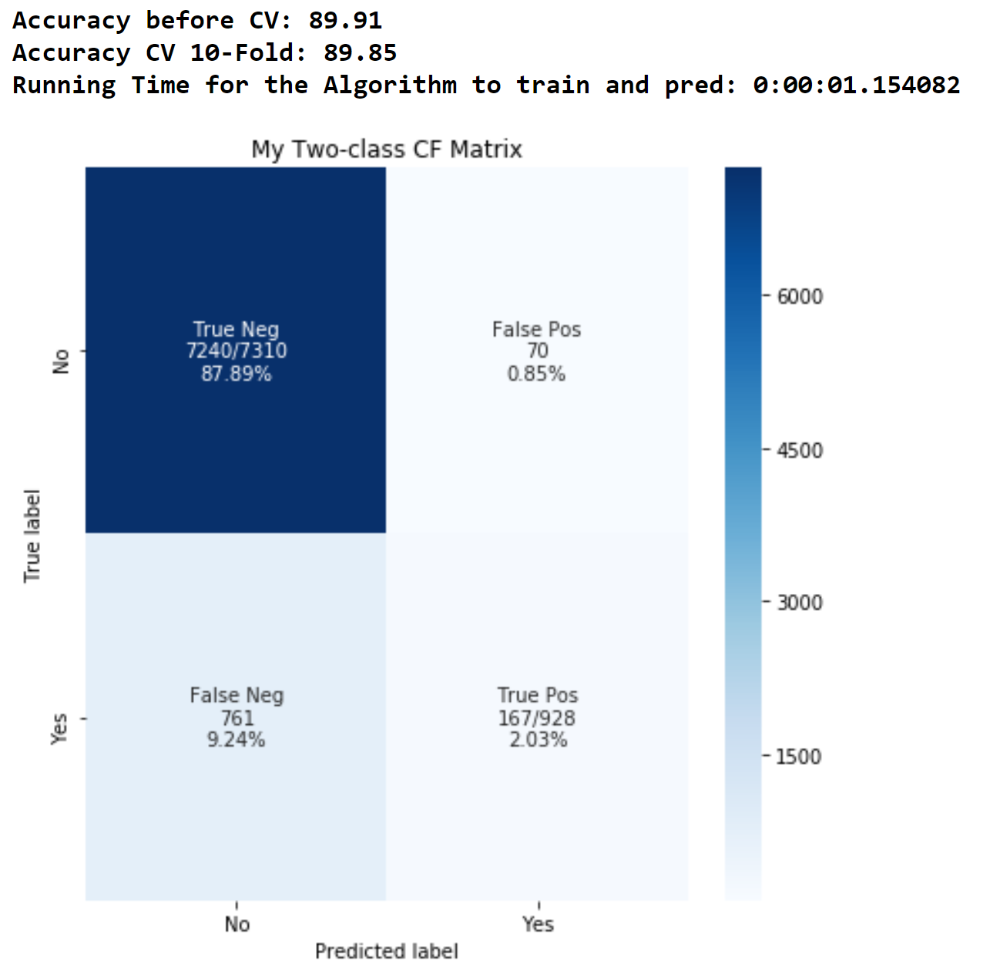
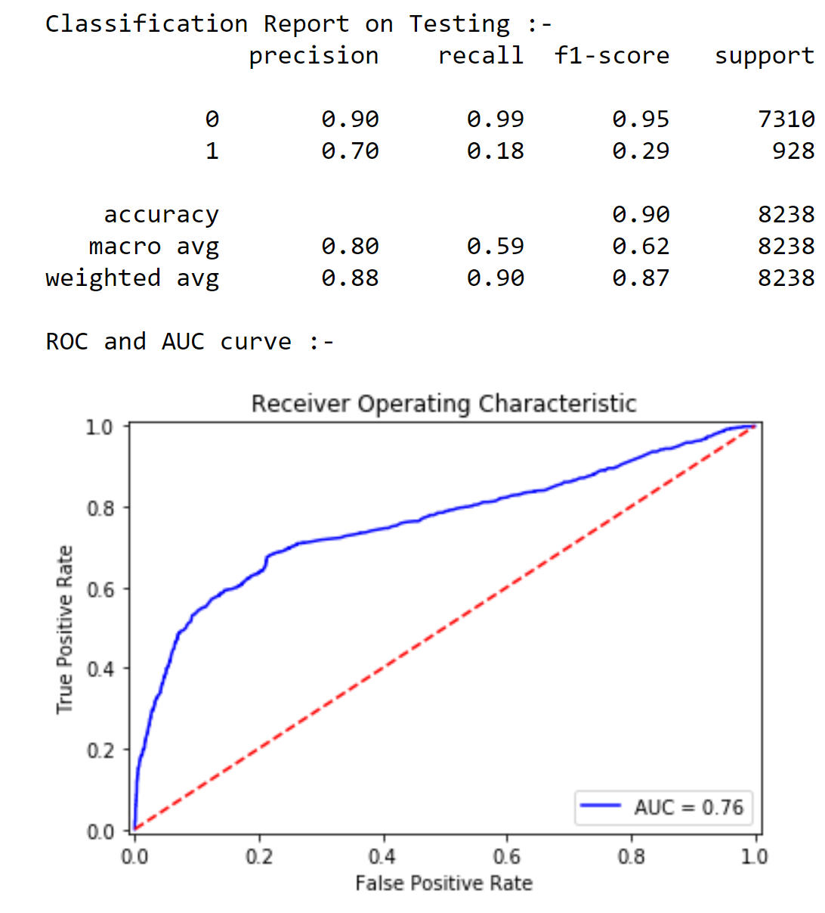
Base Model:-
Notes:
Base Model is used to determine a threshold over the data which shows us how good our data is and whether the data is ready for modeling or some more feature engineering is required
Judging the Base model gives us a very good idea on which prespective of the model we need to work on!
Conclusion on Base Model
The base model shows that the data can be used to train machine learning algorithms giving an accuracy of 89% but the model evaluation also suggests that the current features are not able to capture the variance of the entire dataset in proper sense which is reflected b the AUC value "0.77"
The next step will be building ML Models with a different feature which will take maximum variance of the data in consideration
Additionally trying to train the data on different ML Algorithms to improve the precision and recall
Comparing both the Encoding Techniques it is observed that both the encodings perform similarily on simple linear regression algorithm considering the recall and AUC
So we will try building models using both the encoding techniques and see which ROC and AUC curvers are better

Slide 12
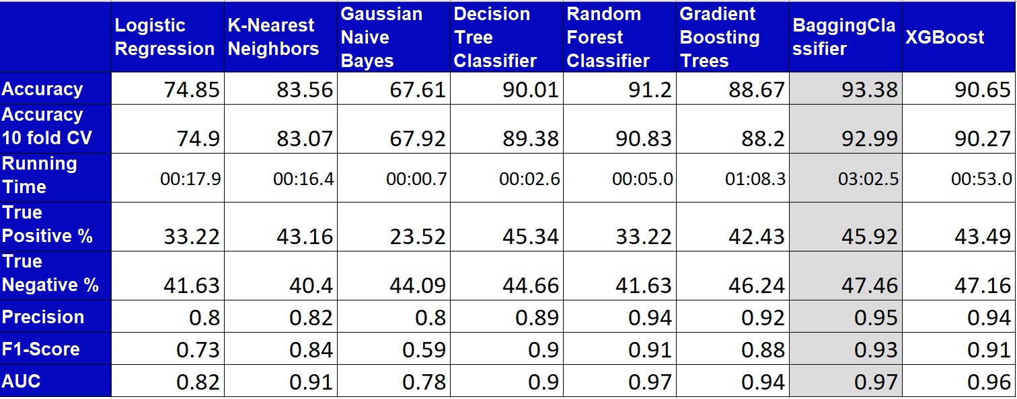
Summary Metrics:-

Slide 13
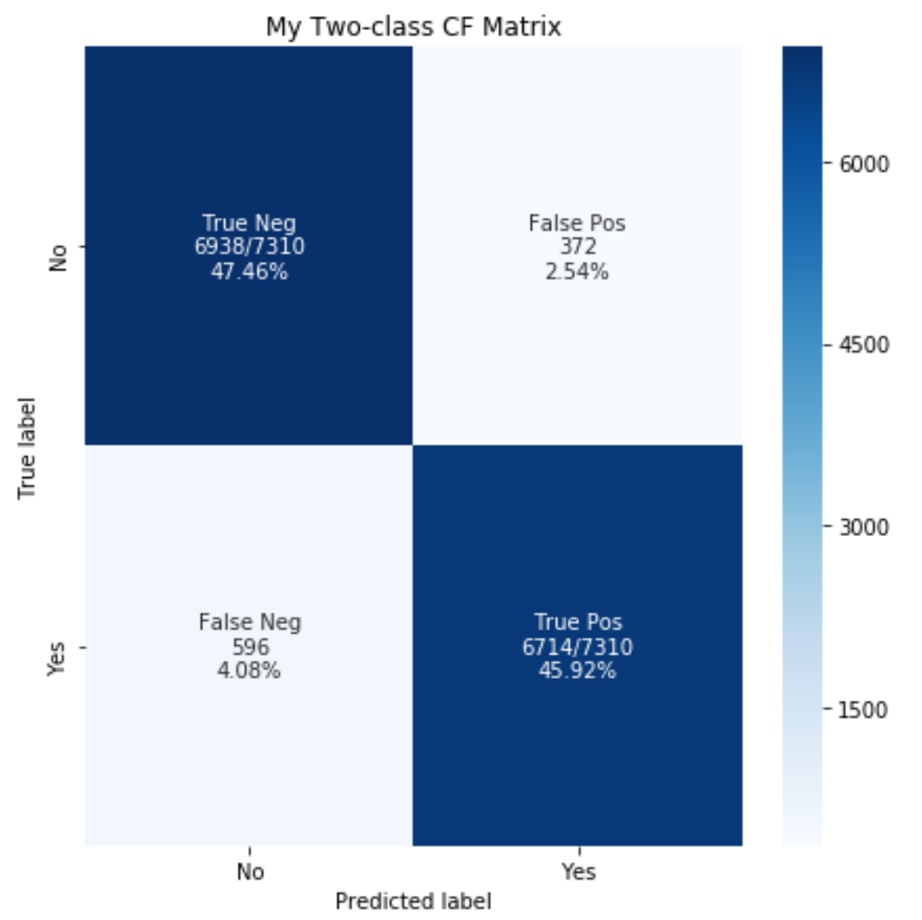
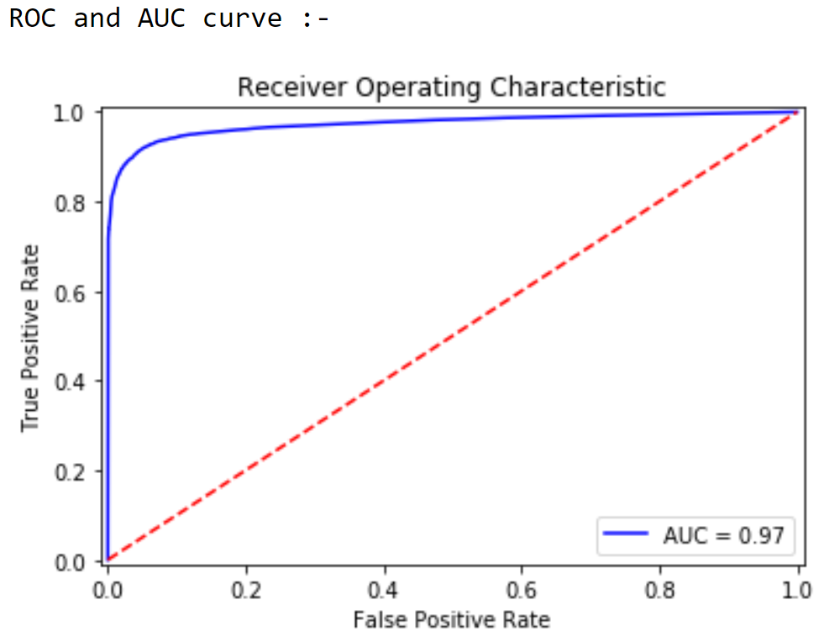
Main Model Summary:-
Bagging Classifier - Accuracy 93%

Slide 14






Conclusion
In the light of overall test accuracy and AUC, and FPR at TPR=0.97, the best model is Bagging Classifier
It has the most powerful prediction ability.
Factors which are most Important and Influence Decision are -
Campaign, nr.employed, euribor3m, age, job, education, day_of_week,previous
Notes:
factors are most important and how these factors influence customers’ decision.

Slide 15




Solutions for the Next Marketing Campaign
Frustrations
euribor3m
Age
Higher LIBOR = lower interest rate
Lower LIBOR = higher interest rate
Targeting customer with 20s or younger and 60s older
younger having 60% chance
eldest having 76% chance
nr.employed
Duration
Job
Higher No of employees = Higher Trust in Bank
Seasonality & day
Longer Call = Higher Customer Acquisition Rate
Shorter Call = Lower Customer Acquisition Rate
Targeting Students and retired professional gives a higher chance of conversion
- Potential Client subscribed in the Fall and Winter Term
- Days to be Targeted are Tuesday, Wednesday, Thursday
Campaign
Objections
Threshold needs to be decided for no of calls to a client . As higher the number of calls happen more likely is customer will reject
Developing Questionnaire
This Questions will help the Bank to increase the duration of call which results into conversion

Slide 16

Thank you and Questions

